Slide 1
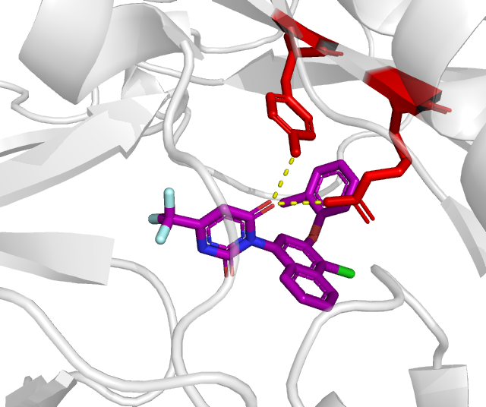
A.
Y127
R129
BAY-069 Inhibitor

